Slide 1


Doug’s Ed-Fi Tips and Tricks
Douglas Loyo
Passionate Technologist Focused on Changing Students Lives
Father, Husband, Mentor, Entrepreneur, CEO, CTO, Sr. Solutions Architect, UI Expert
douglas.loyo@msdf.org

Slide 2
Whatever it takes to make it happen!
Tips and Tricks Agenda:
Prerequisites – What you will need.
Install: SSMS – Sql Server Management Studio
Download and Restore Ed-Fi ODS Db
Finding Tables by Educational Domain
3 handy SQLs
Diagrams are the treasure maps of databases. (Find the X)
SSMS – Sql Server Management Studio
Create Diagrams
Add Related Tables
Foreign Keys and Joins
Sharing diagrams to the community. (Git, PowerShell and SQL)
Git repo:
Hacky data strategies: (Use at your own risk =)
Excel that generates SQL statements
SQL that generates SQL statements
Linked Servers and Inter Db queries
Professional ETL tool

Slide 3
Prerequisites – What you will need
Download files in my github repo. (https://github.com/dougloyo/Dougs-Ed-Fi-Tips-and-Tricks)
Install SSMS: SQL Server Management Studio (https://docs.microsoft.com/en-us/sql/ssms/download-sql-server-management-studio-ssms)
Download an Ed-Fi ODS (https://s3-us-west-2.amazonaws.com/edfidata/ETL+Development/EdFi_Glendale_v31-20190116.7z)
Restore the Ed-Fi ODS on your test server or local machine.
Ensure everything is good with diagram creation. (Look at know issues and fixes)

Slide 4
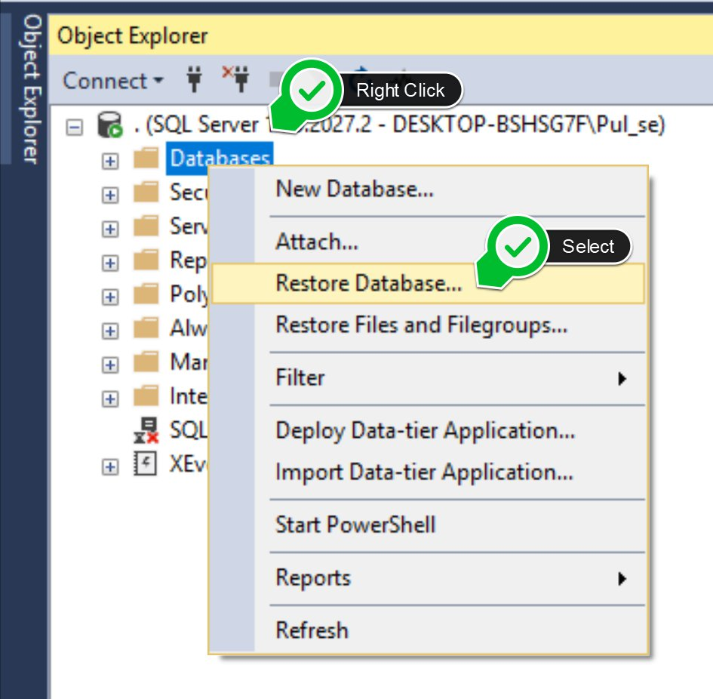
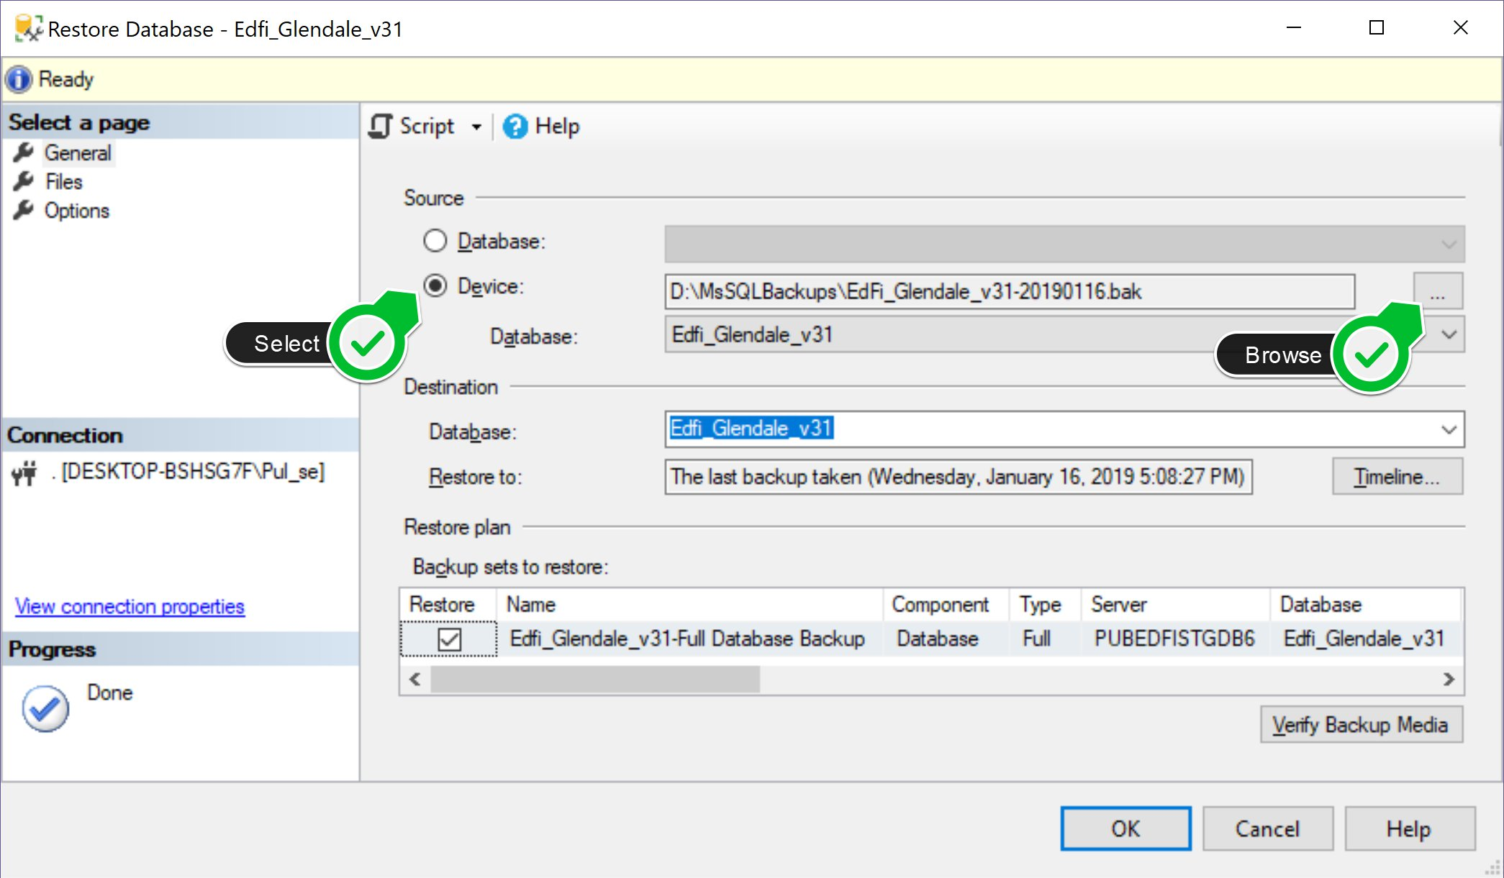
Restoring the Ed-Fi ODS 1/3
1) Open SSMS, select “Restore Database”
2) Select Device then Browse for file

Slide 5
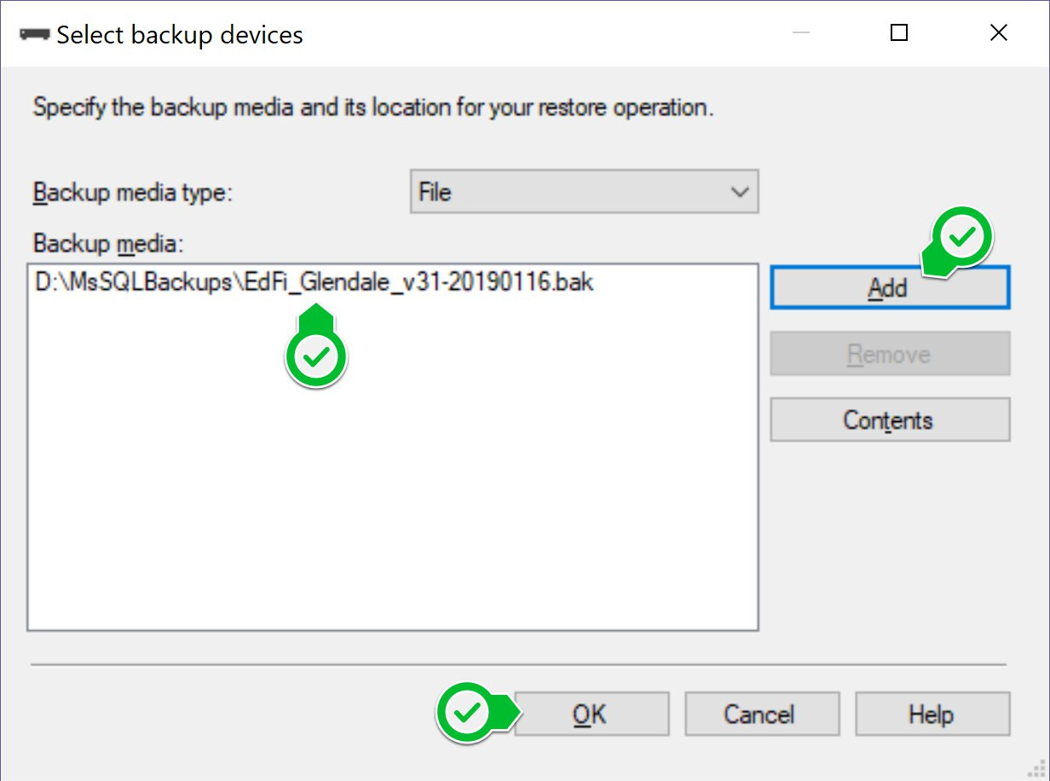
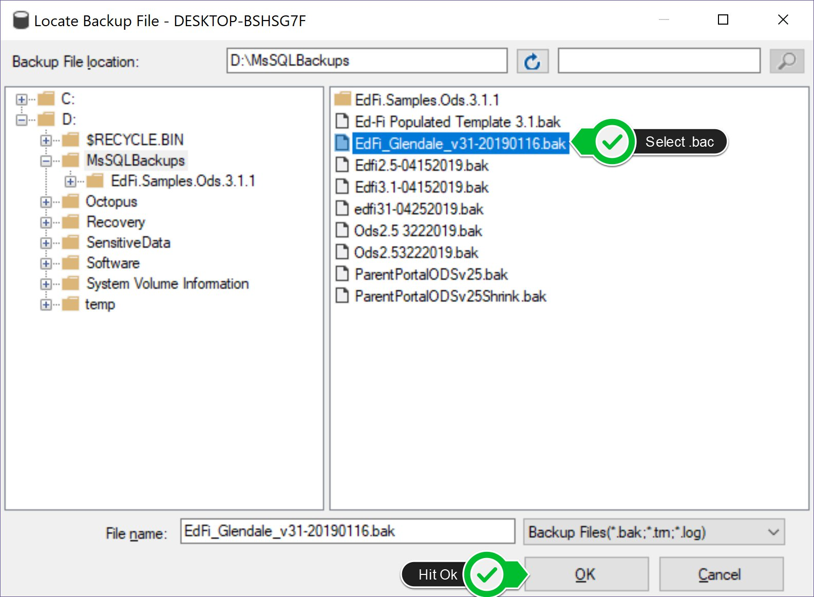
Restoring the Ed-Fi ODS 2/3
3) Click Add
4) Select *.bac file. Click OK

Slide 6
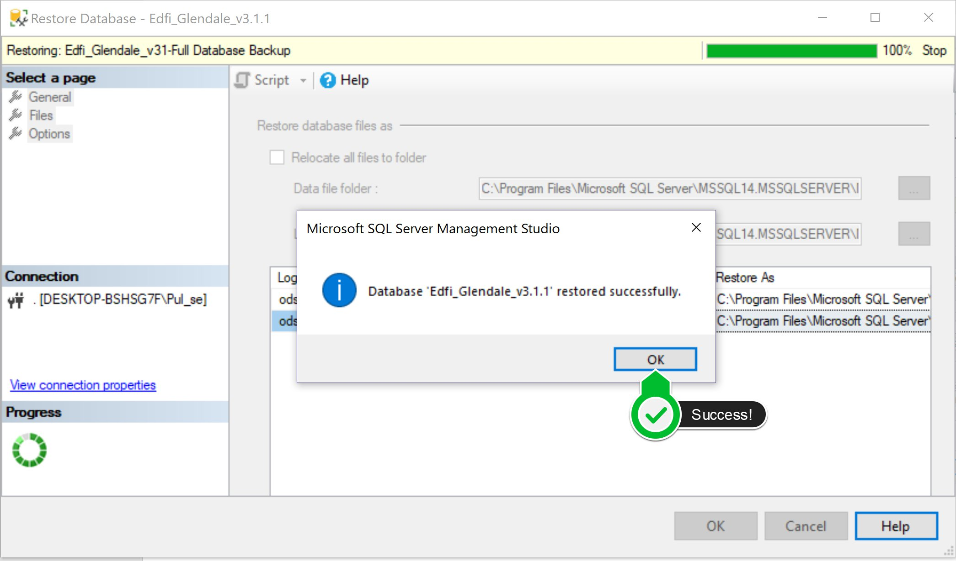
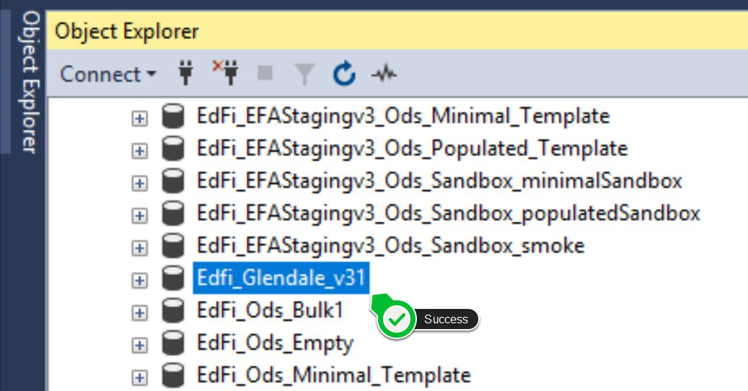
Restoring the Ed-Fi ODS 3/3
5) Success Message. Click Ok
6) View Db in tree.

Slide 7
Finding Tables by Educational Domain
/*Search all tables with name like*/
SELECT *
FROM INFORMATION_SCHEMA.TABLES
WHERE TABLE_TYPE = 'BASE TABLE’
and TABLE_CATALOG = 'EdFi_Glendale_v31’
and TABLE_NAME like '%atten%';
/*Search columns*/
SELECT c.name AS 'ColumnName', t.name AS 'TableName'
FROM sys.columns c
JOIN sys.tables t ON c.object_id = t.object_id
WHERE c.name like '%instructional%'
ORDER BY TableName, ColumnName;
/*Search Descriptors*/
SELECT * FROM edfi.Descriptor
WHERE --CodeValue like '%Abs%'
Namespace like '%AttendanceEventCategoryDescriptor%';
3 useful sql:

Slide 8
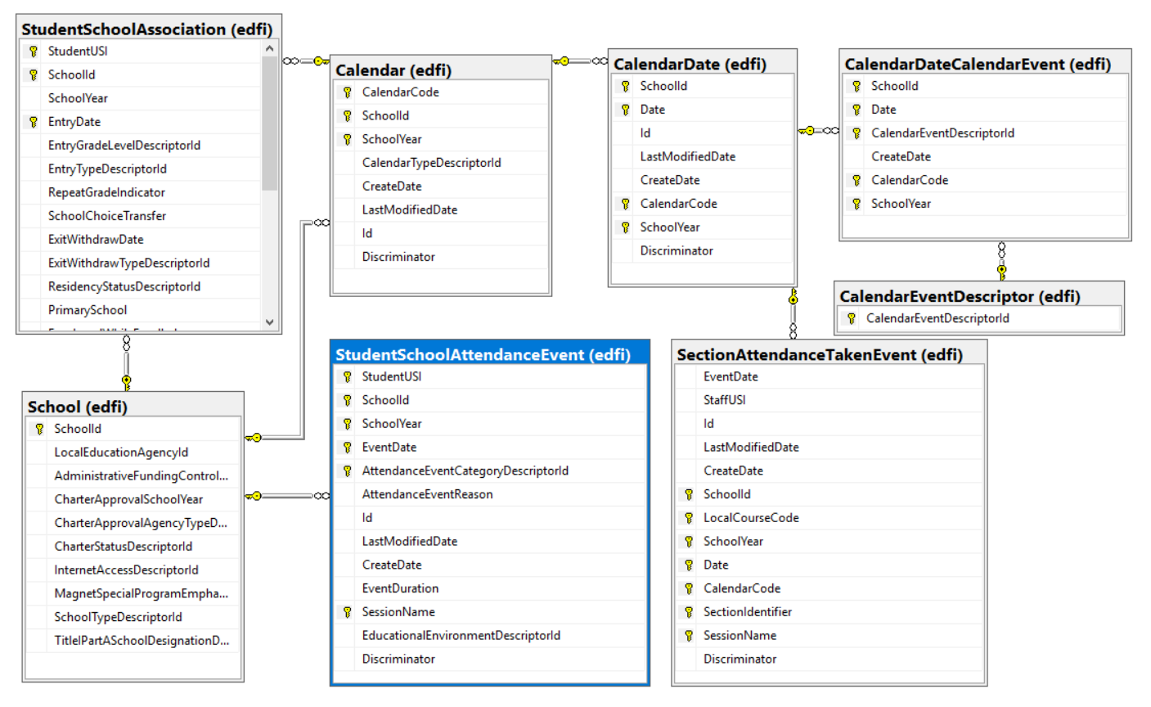

Diagrams are the treasure maps of databases.
(Find the X)

Slide 9
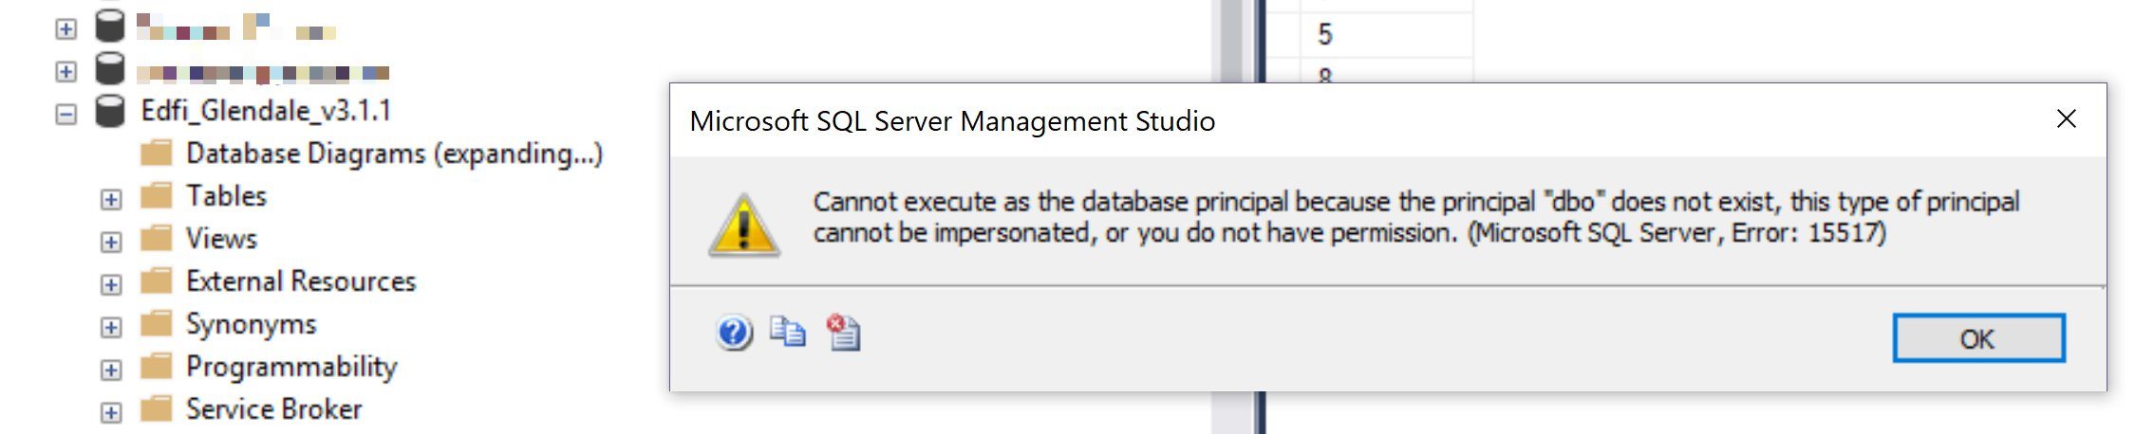
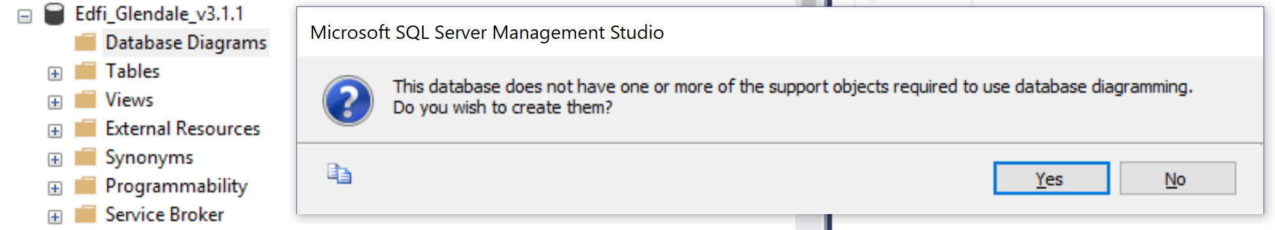
Diagraming Known Issues and Fixes
1) Error: cannot execute as the database principal because the principal dbo does not exist
Resolution: USE [YourDatabaseName] EXEC sp_changedbowner 'sa’;
2) Info: This database does not have one or more of the support objects required to use database diagramming.
Do you wish to create them? Resolution: Click Yes.

Slide 10
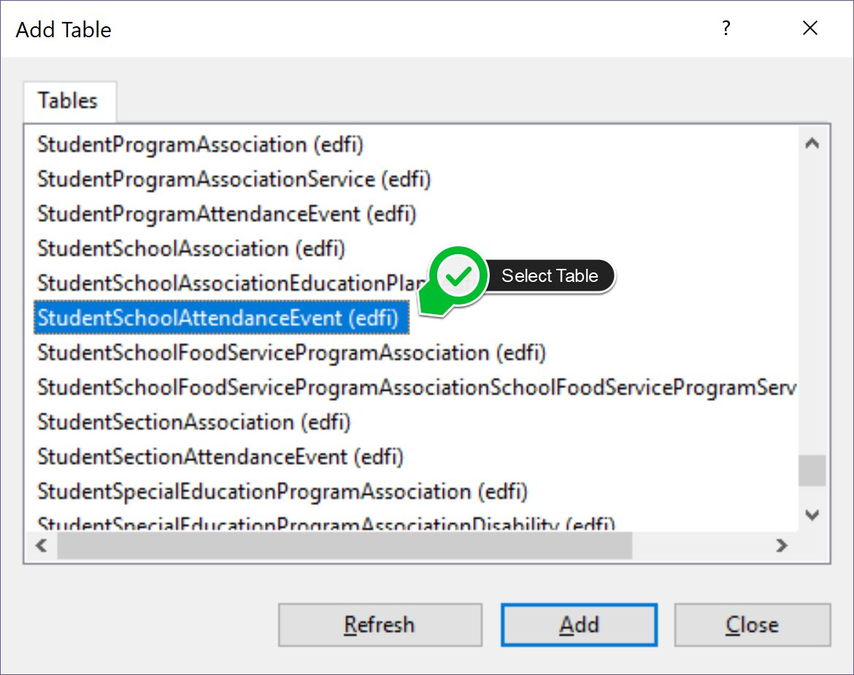
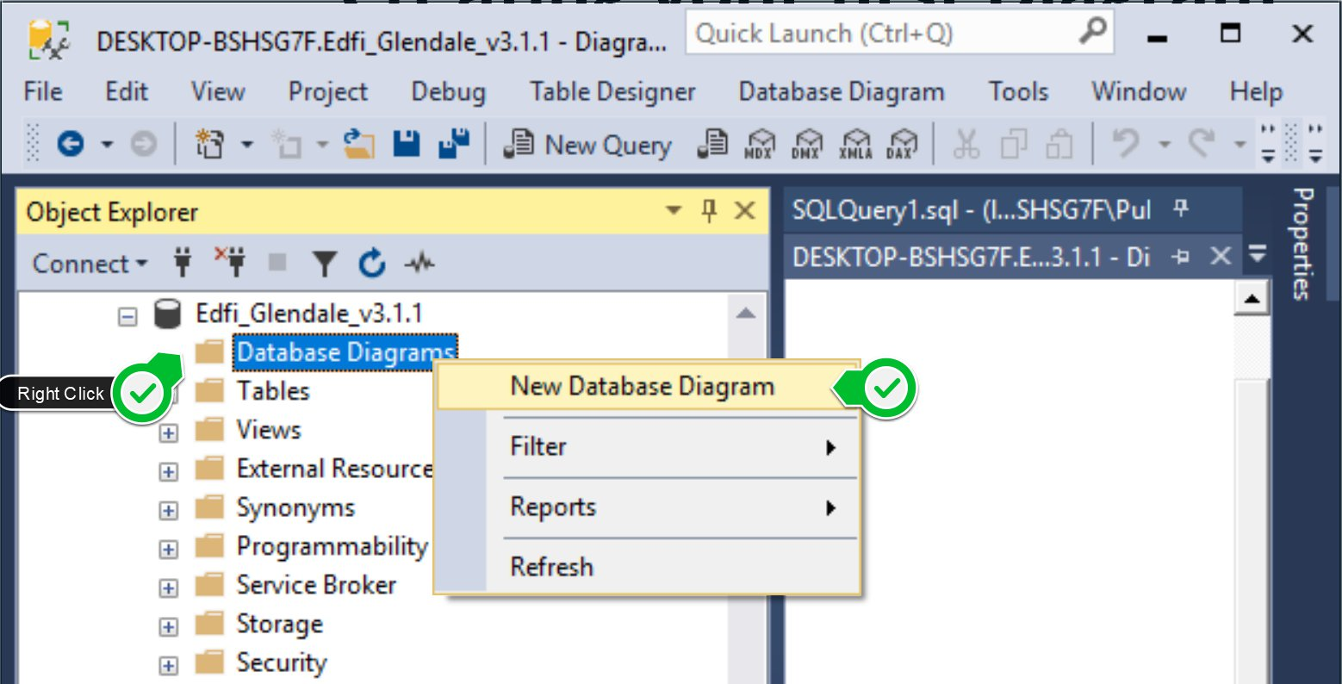
Creating your first Diagram
Have and objective: “Student Daily Attendance”
Find tables you think you will need. Use queries.
Add related tables. (Right click relations, view props)
Write SQL taking into account key relationships.
Save your diagram and share.

Slide 11
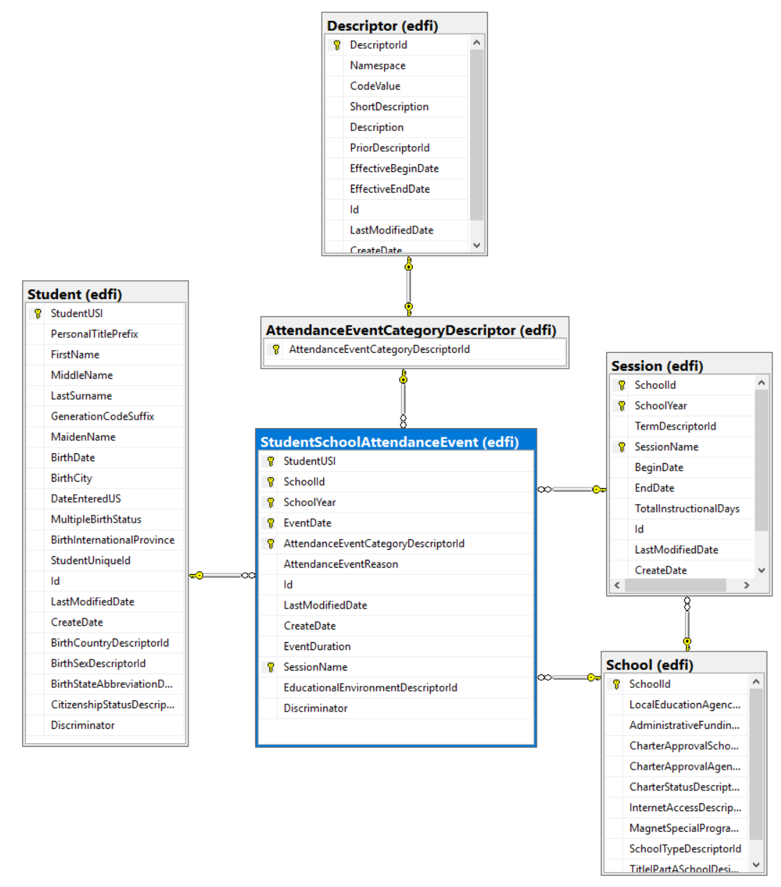
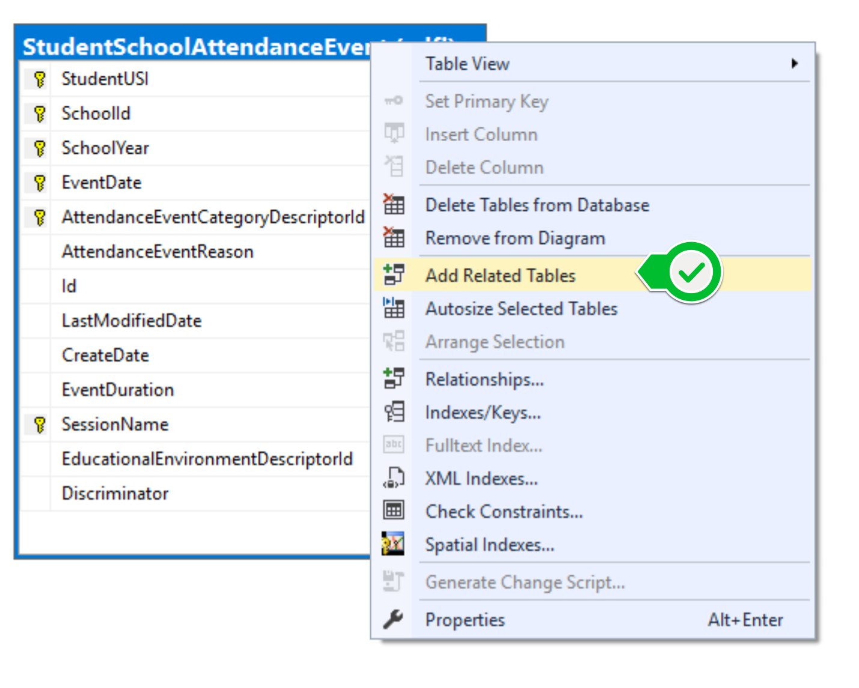
Diagram: Student Daily Attendance
*Tips: -- Ctrl + Click to move tables that got added underneath
-- Arrange tables

Slide 12
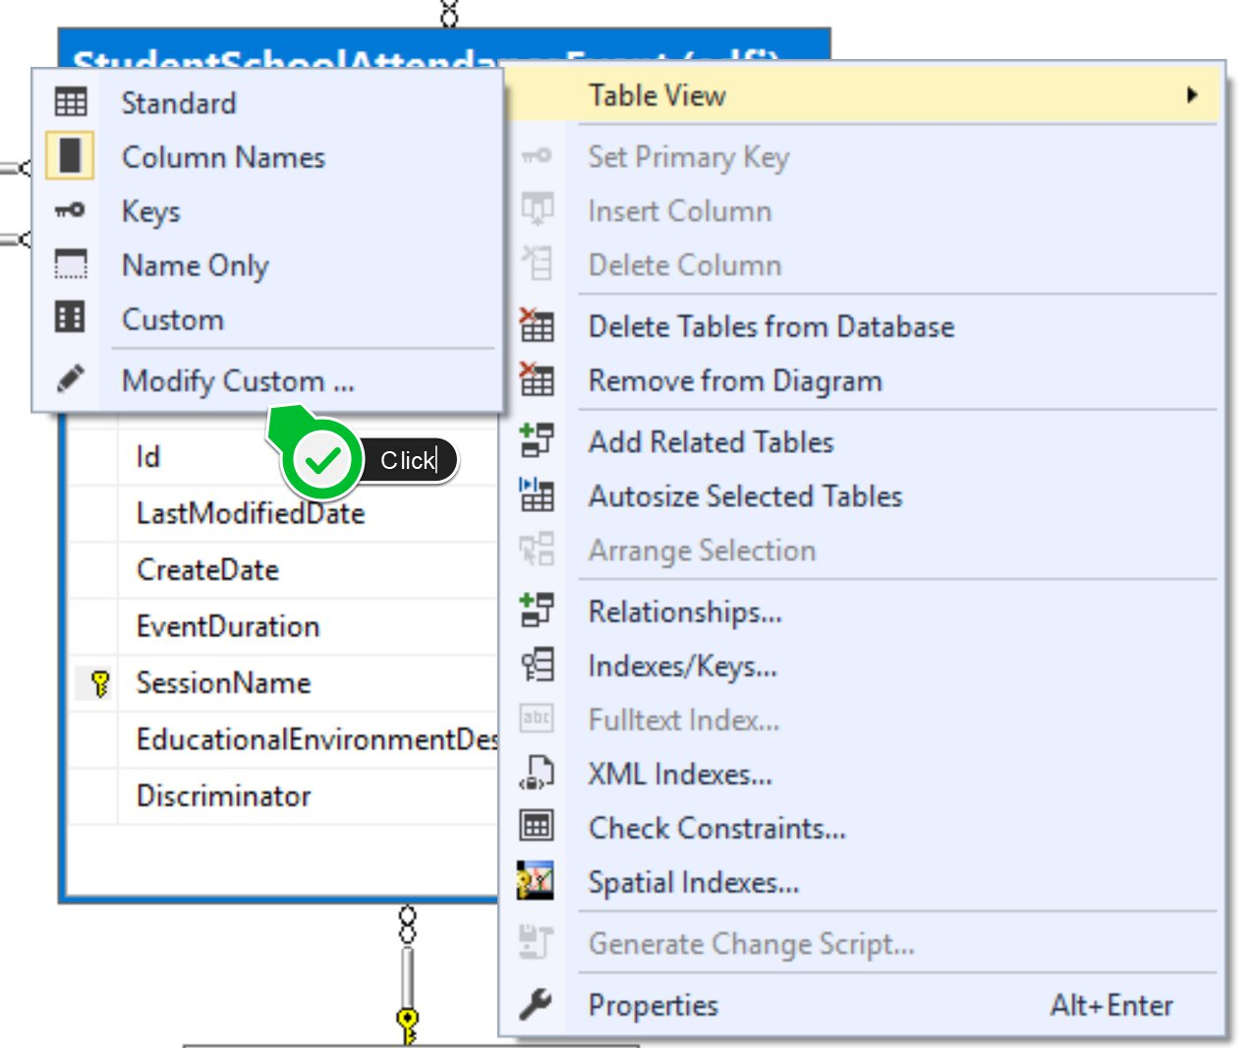
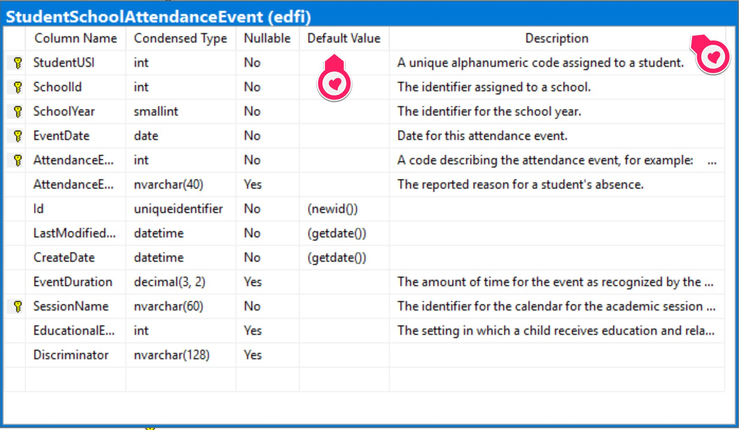
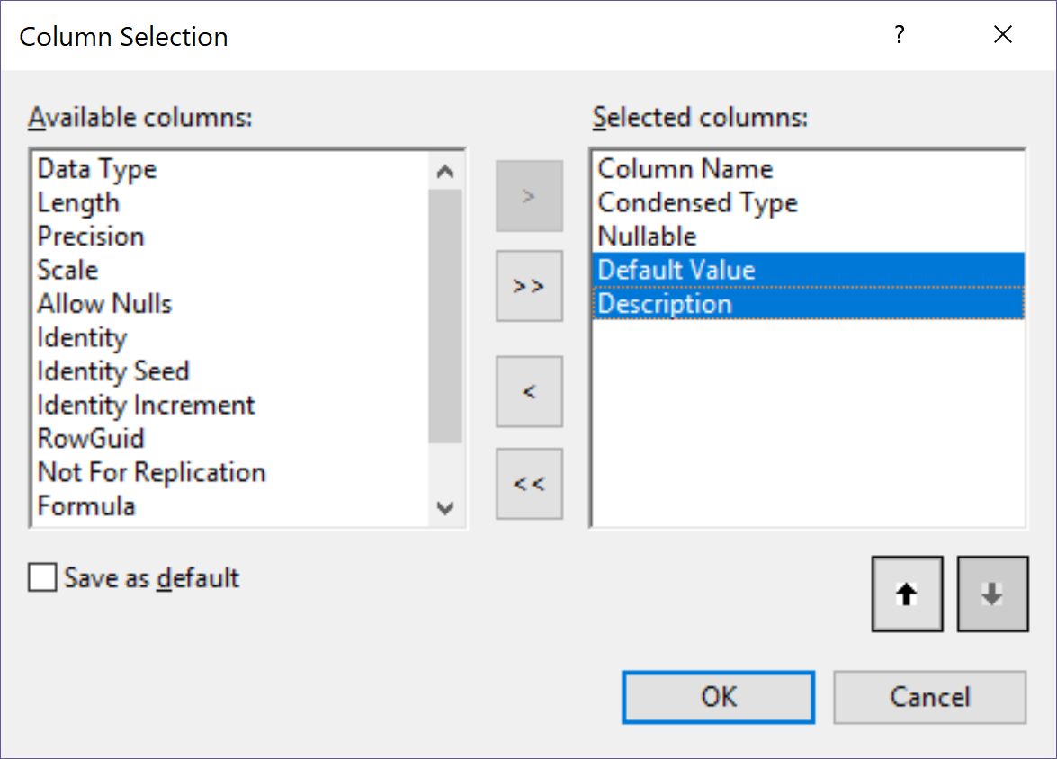
Diagram and Table Metadata
*Tips: -- Right click the table and select “Table View” -> “Modify Custom …”
-- Add columns “Default Value” and “Description
-- Right click the table and select “Table View” -> “Custom”

Slide 13
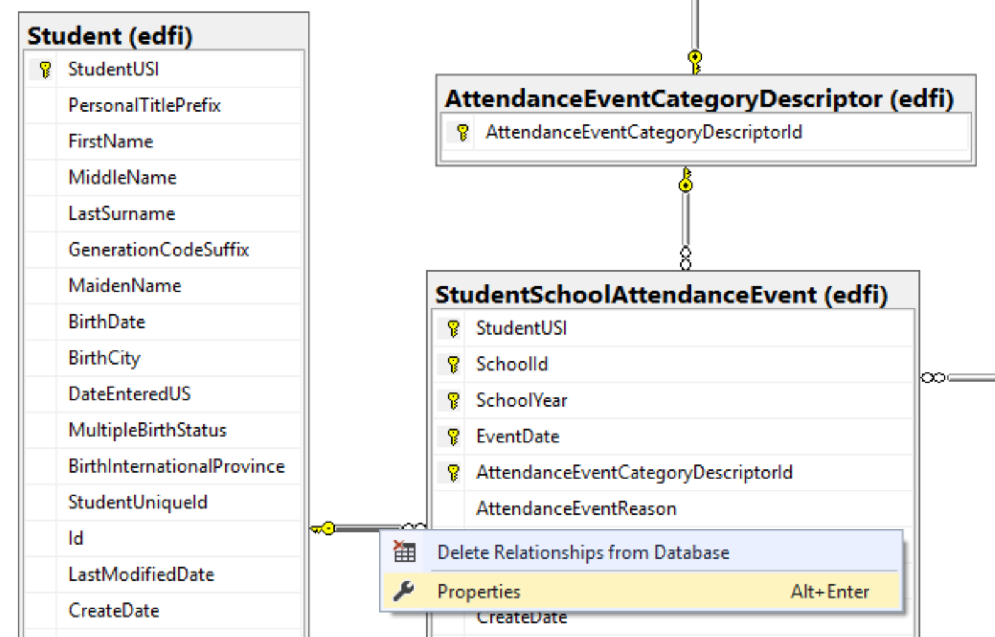
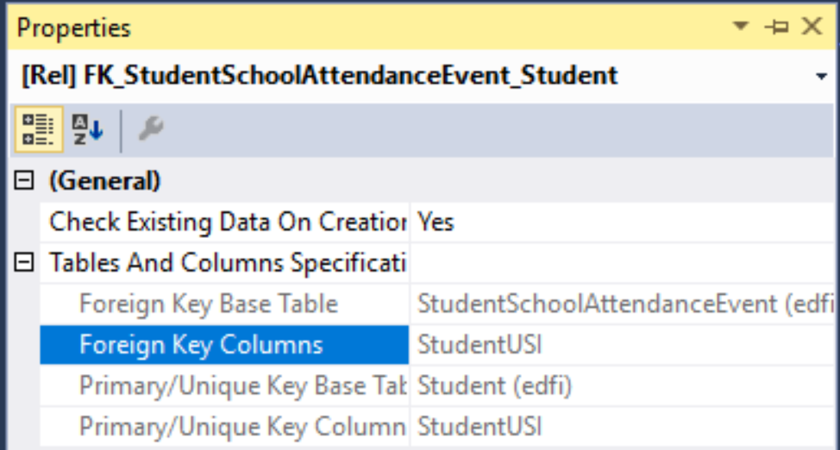
SQL: Student Daily Attendance
SELECT S.StudentUSI, S.FirstName, S.LastSurname, SAET.CodeValue, COUNT(ssae.EventDate) as Absences
FROM edfi.Student S
LEFT JOIN edfi.StudentSchoolAttendanceEvent SSAE on S.StudentUSI = SSAE.StudentUSI
LEFT JOIN edfi.Descriptor SAET on SSAE.AttendanceEventCategoryDescriptorId = SAET.DescriptorId
GROUP BY S.StudentUSI, S.FirstName, S.LastSurname, SAET.CodeValue
ORDER BY COUNT(ssae.EventDate) desc

Slide 14
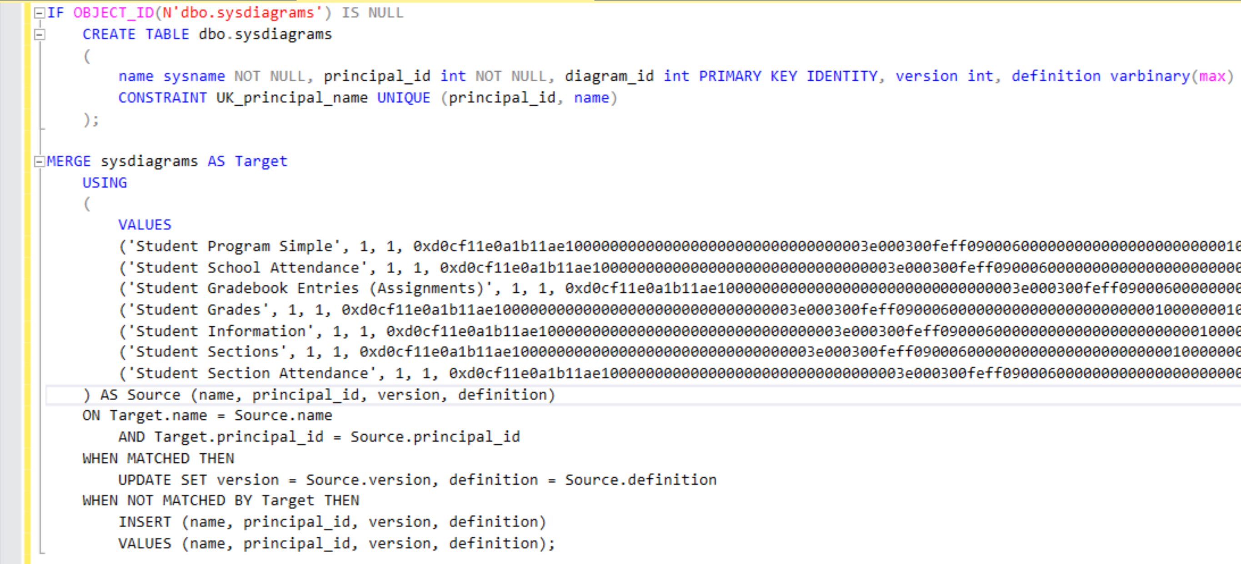
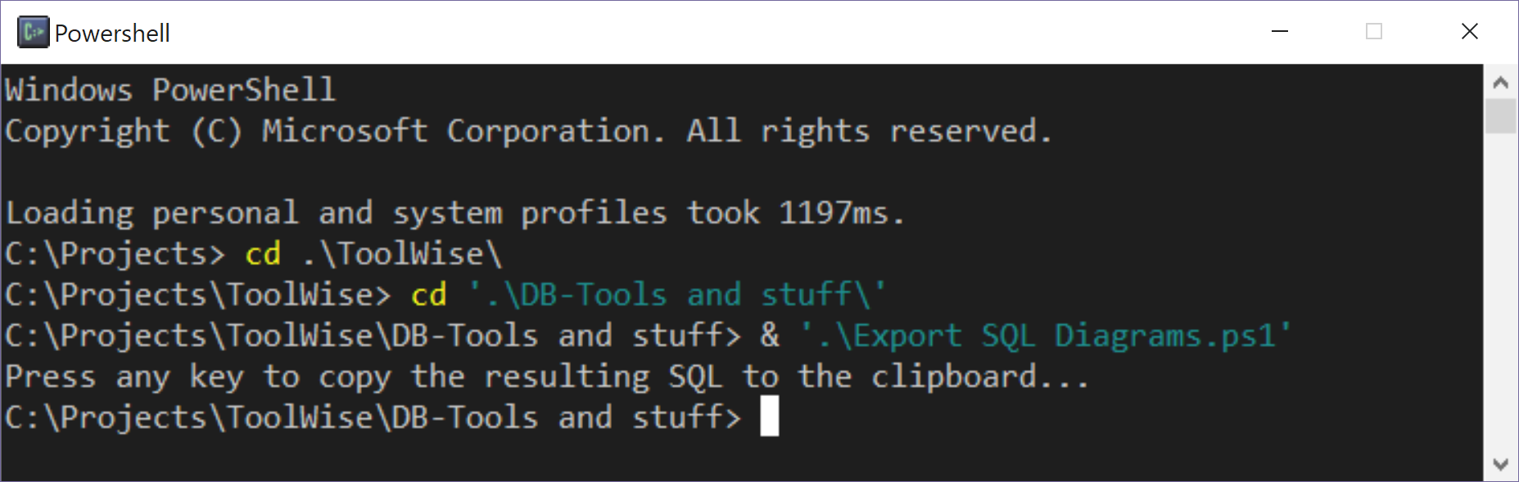
Diagrams: Sharing Back to the Community
*Tip: -- Use PowerShell script Export SQL Diagrams.ps1 (not created by me)
-- Update connection string in the .ps1 file.
*Gotchas:
You can run the SQL from the .ps1 in SSMS but it truncates the resulting text.
Use the PowerShell script to run the query copy output to the clipboard.
https://stackoverflow.com/questions/18246965/how-can-i-script-sql-server-database-diagrams

Slide 15
Hacky data strategies: (Use at your own risk =)
Disclaimer: The prescribed way of getting data into the Ed-Fi ODS is through the Ed-Fi ODS API.
We strongly recommend that you do everything in your power make data flow through the API. Continue motivating your vendors to get Ed-Fi certified and push the data in from the Ed-Fi ODS API.
Haven said this: and if you are a doer like me.
Do everything it takes to help students' education!

Slide 16
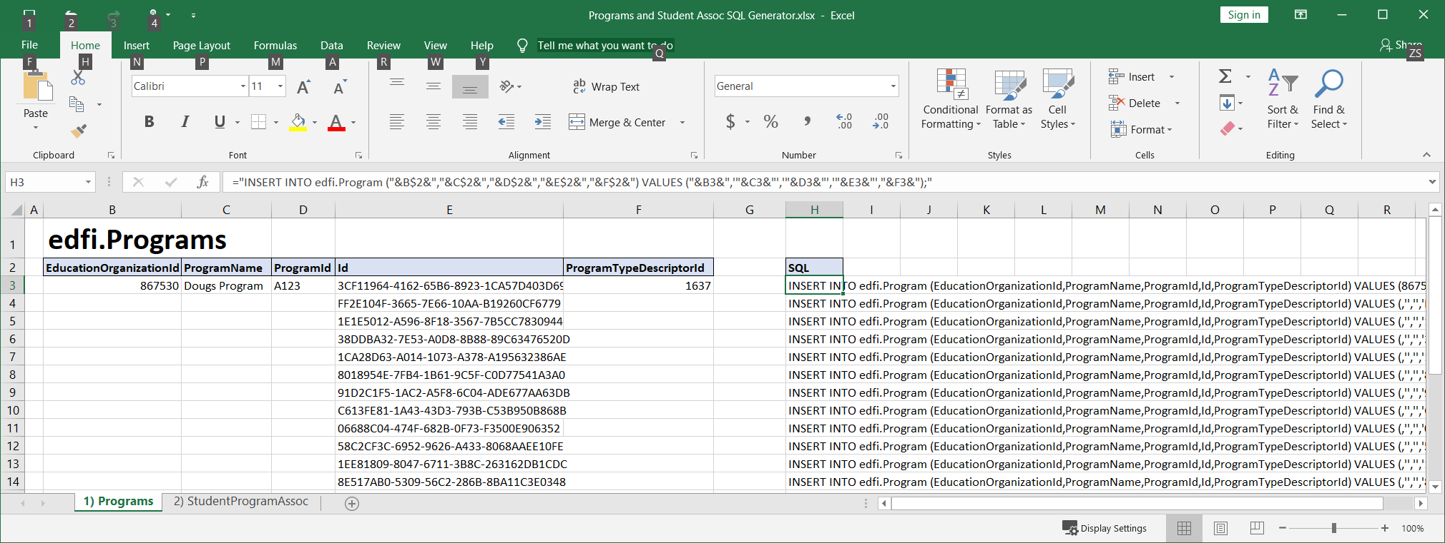
Hacky data strategies: (Use at your own risk =)
Excel generate my SQL! (File: Programs and Student Assoc SQL Generator.xlsx)
Strategy best used when a vendor gives us CSVs

Slide 17
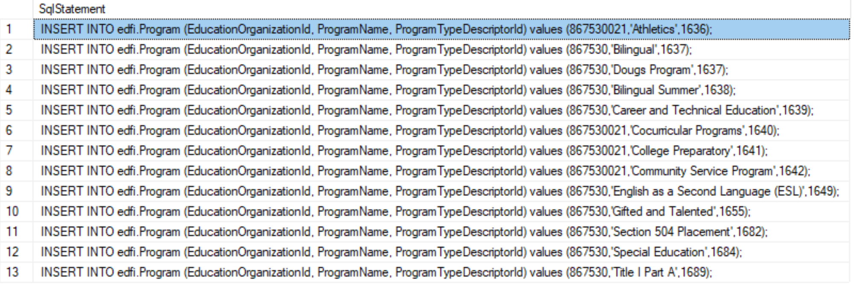
Hacky data strategies: (Use at your own risk =)
2) SQL generate my SQL!
SELECT
'INSERT INTO edfi.Program (EducationOrganizationId, ProgramName, ProgramTypeDescriptorId) values (‘
+ CONVERT(nvarchar,EducationOrganizationId) + ',''' + ProgramName + ''',’
+ CONVERT(nvarchar,ProgramTypeDescriptorId) + ');’
as SqlStatement FROM edfi.Program;
-- Instead of edfi.Program you would use whatever you need from your source Db.

Slide 18
Hacky data strategies: (Use at your own risk =)
3) SQL do the magic! (SELECT INSERT)
Use when the Db is on the same server or you can do a linked database.
INSERT INTO [destinationServer].[destination_dbName].[edfi].[Program]
(EducationOrganizationId, ProgramName, ProgramTypeDescriptorId)
SELECT column1, column2, column3,
FROM [sourceServer].[source_dbName].[schema].[table] WHERE condition;
--And you can get more elaborate by joining all tables you need in the secondary select.

Slide 19

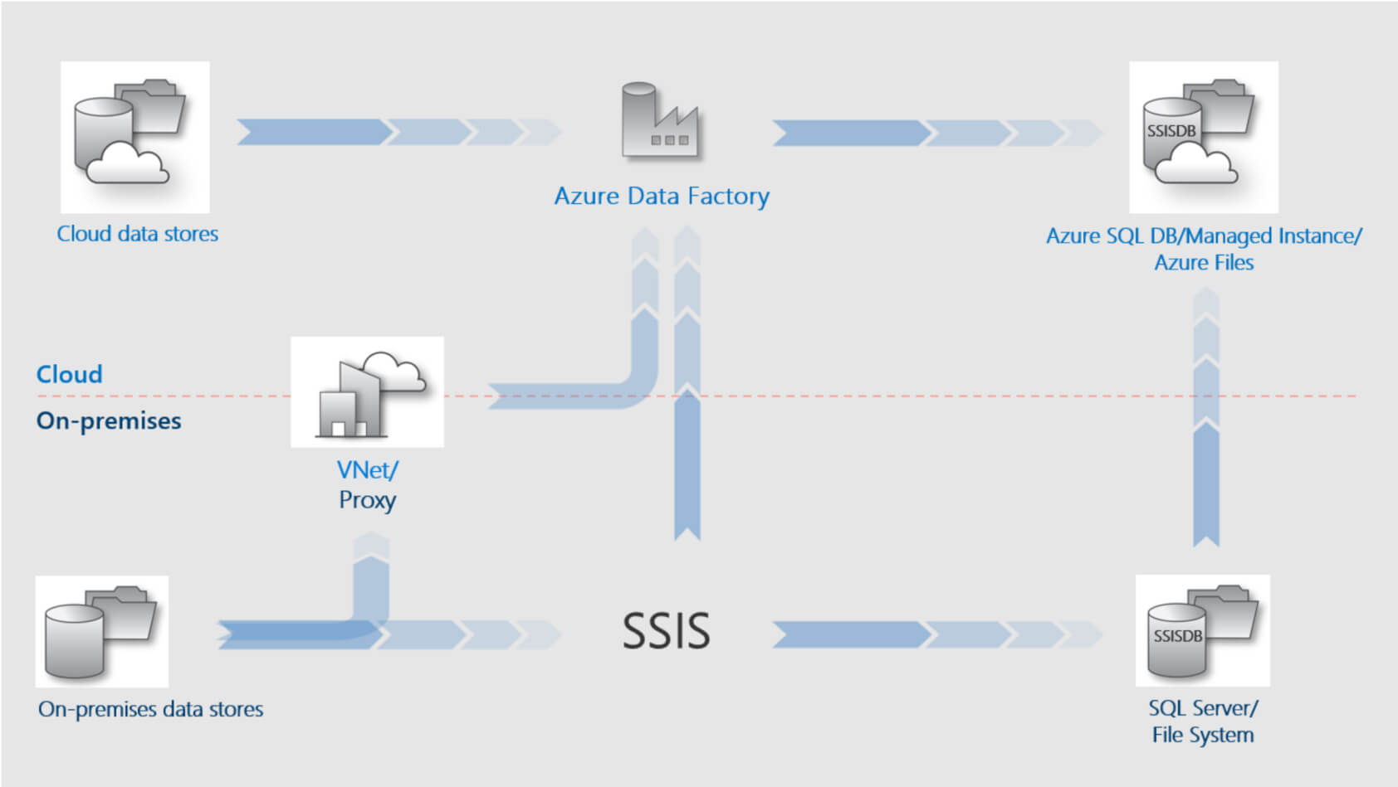

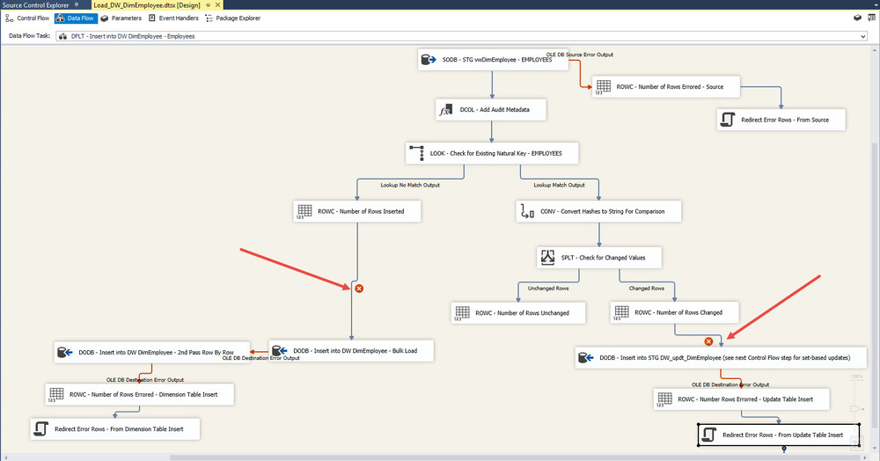

Not Hacky Data Strategy
4) Industry standard ETL software (Extract Transform and Load)
Use form complex logic of extracting from a source database, transforming and loading
into destination database.

